Slide 1



MANAGEMENT
FUNCTIONS

Slide 2
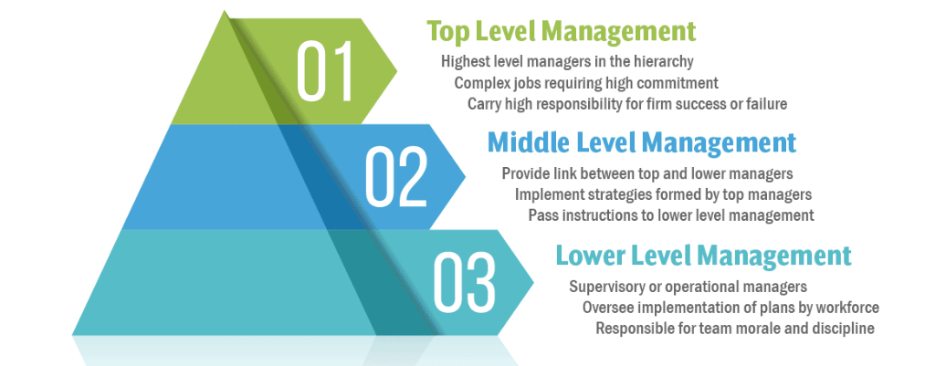
DIFFERENT LEVELS OF MANAGEMENT

Slide 3






DIFFERENET FUNCTIONS OF MANAGEMENT
The functions of management are a set of core activities that are essential for the effective operation and success of any organization. These functions are generally categorized into five main areas:
Planning
Organizing
Staffing
Directing
Controlling
POSDC

Slide 4

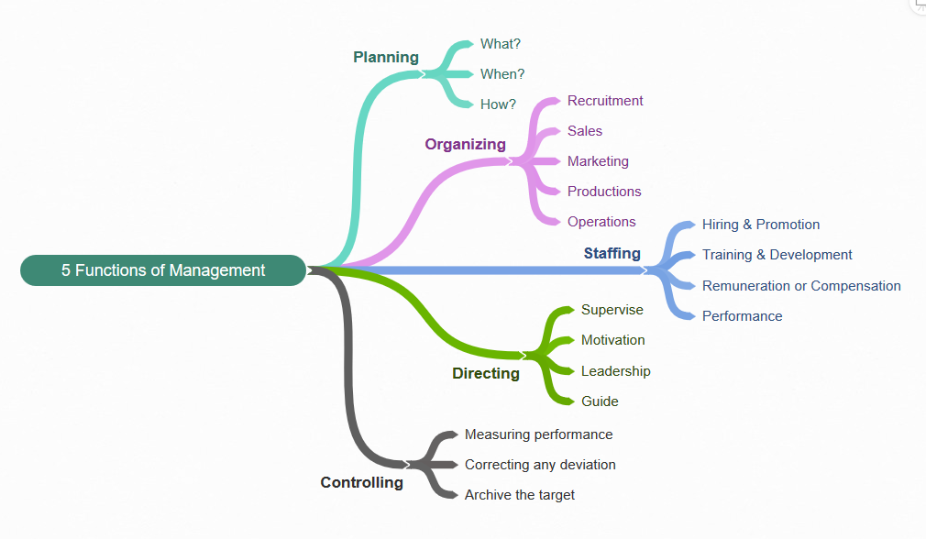
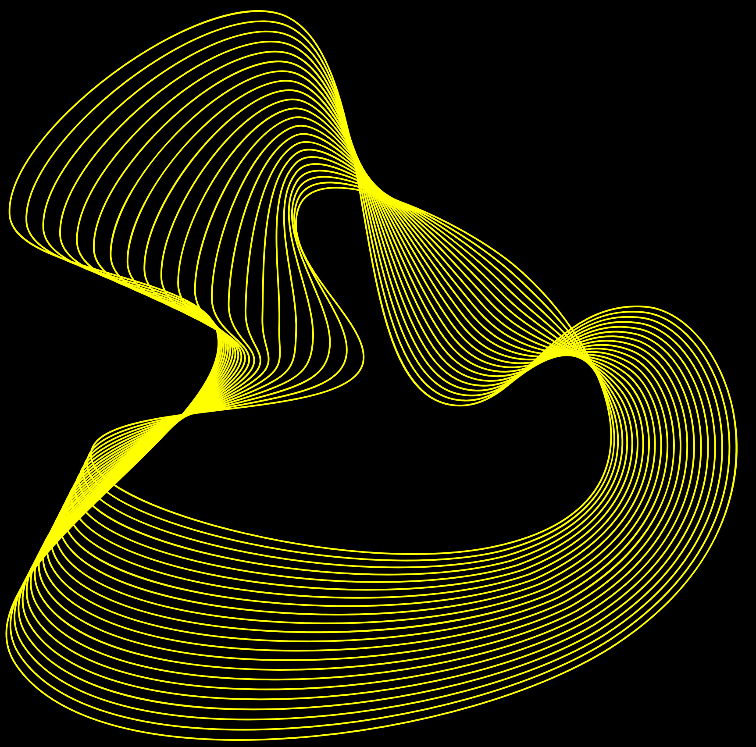
Activities of Different Functions

Slide 5


Slide 6

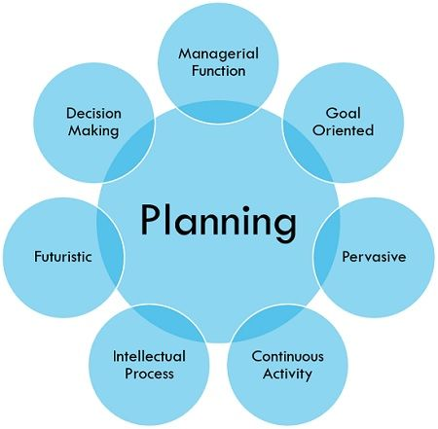
PLANNING
Definition
Planning is the fundamental management function, which involves deciding beforehand, what is to be done, when is it to be done, how it is to be done and who is going to do it. It is an intellectual process which lays down an organization's objectives and develops various courses of action, by which the organization can achieve those objectives. It chalks out exactly, how to attain a specific goal.

Slide 7
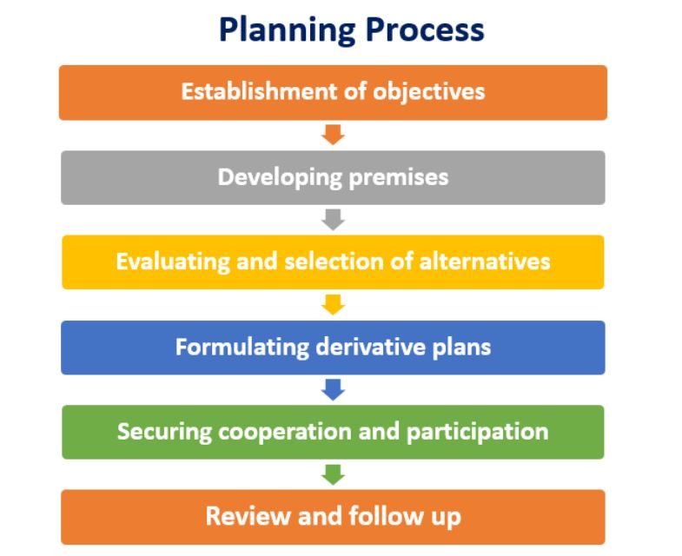

Slide 8


Slide 9
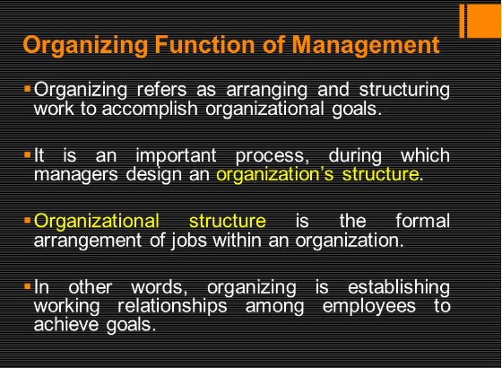

Slide 10
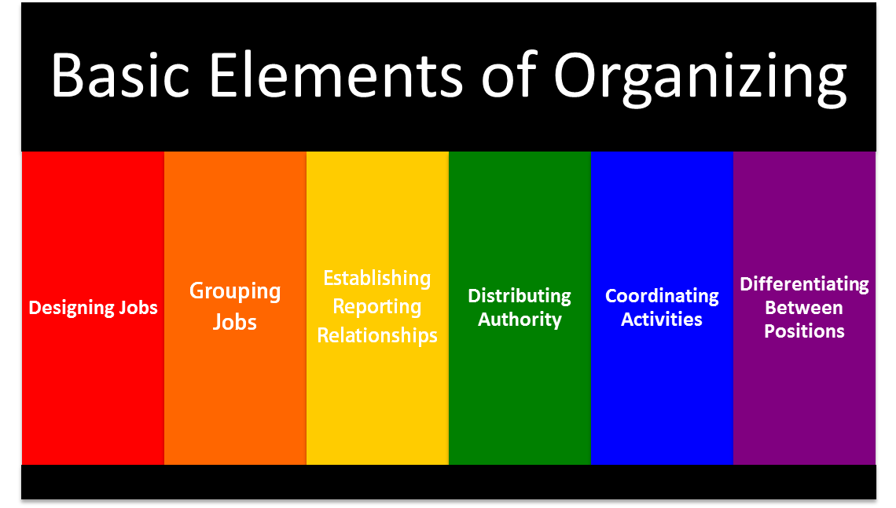

Slide 11
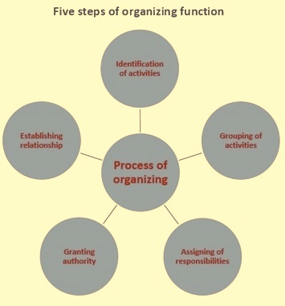

Slide 12


Slide 13

STAFFING
Definition
It is a process through which capable employees are selected, recruited, properly trained, effectively developed, rightfully rewarded.

Slide 14
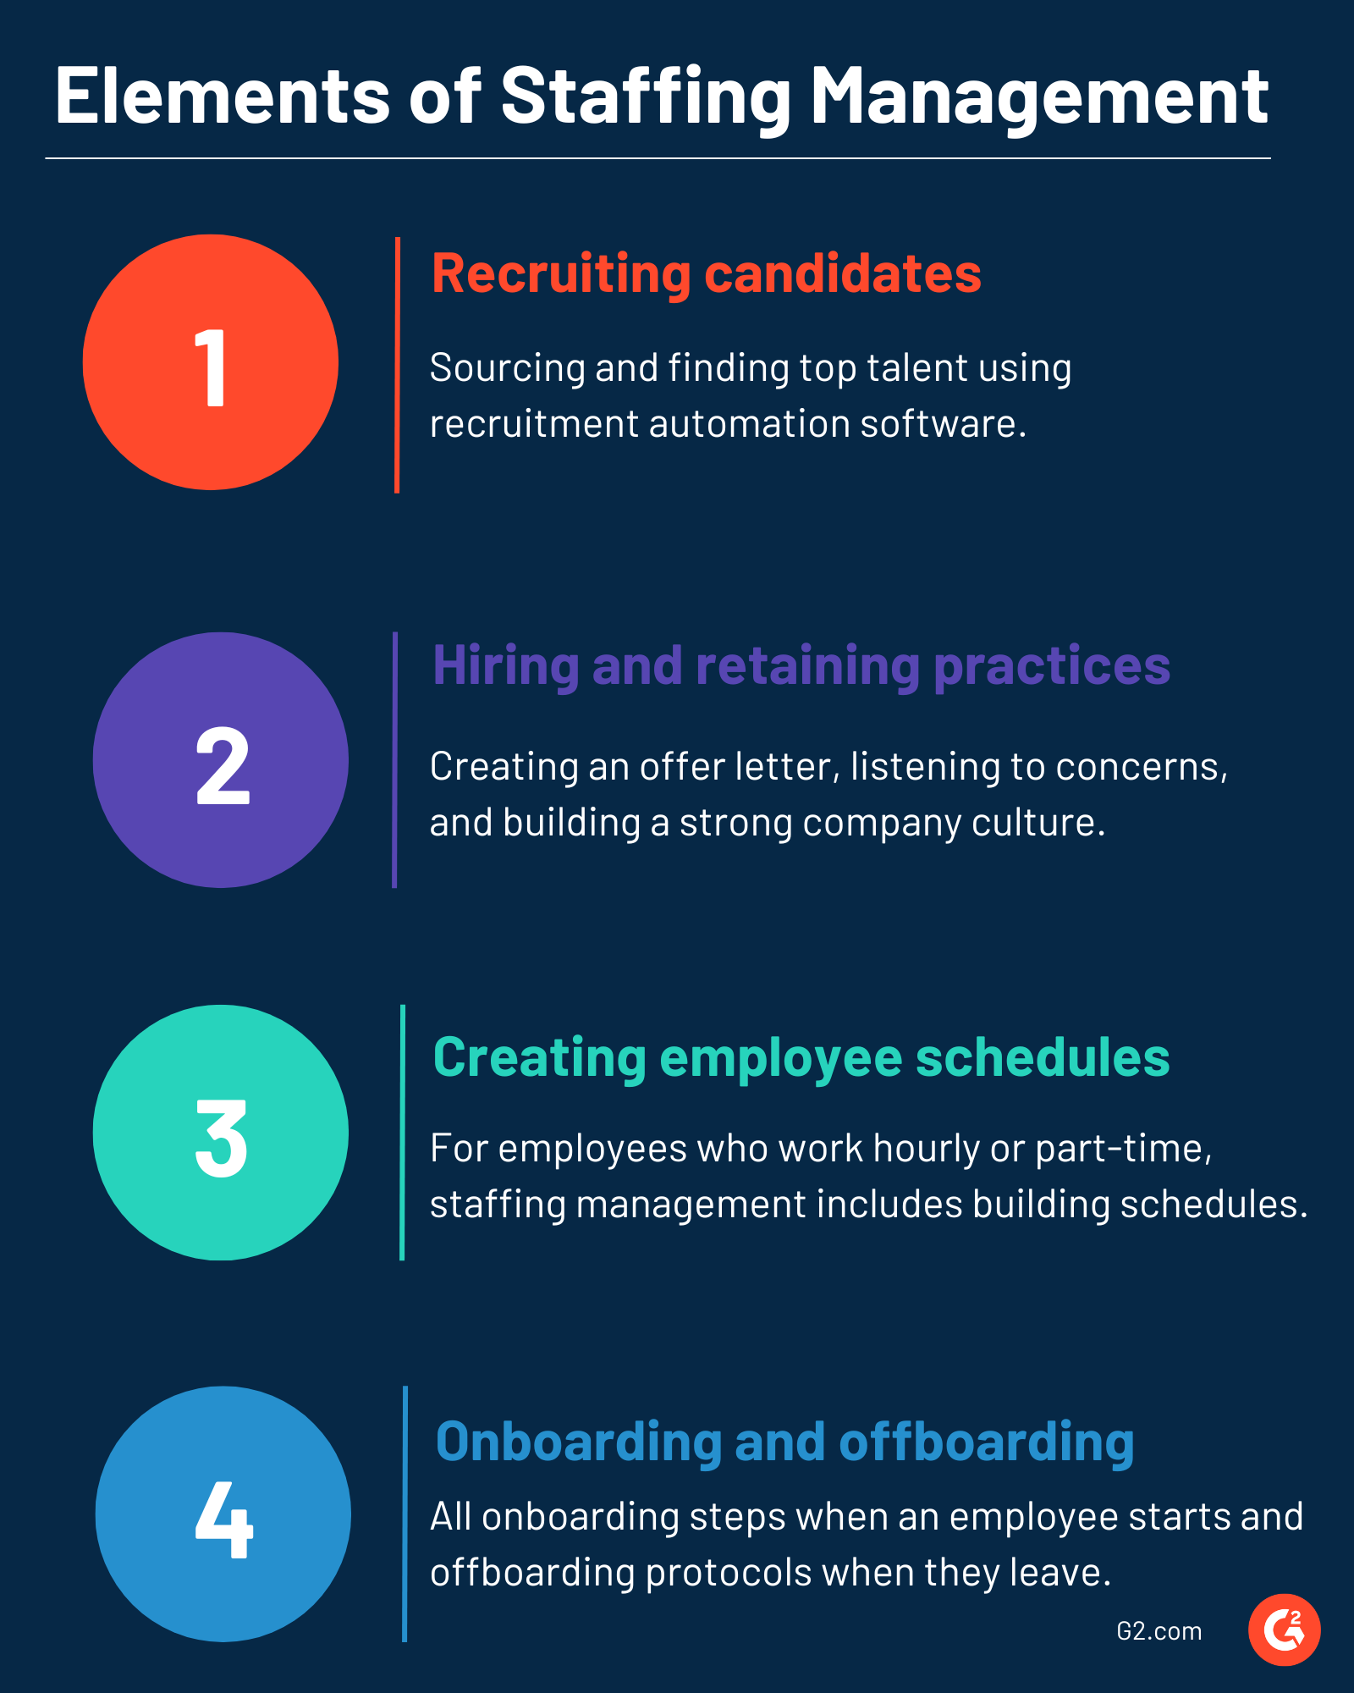

Slide 15
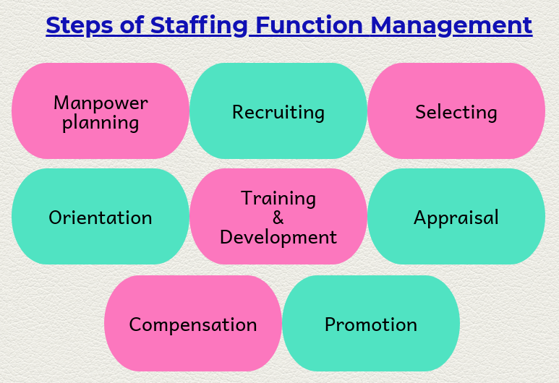

Slide 16


Slide 17

Directing or Leading
Definition
The direction process in management involves the manager guiding, instructing, and looking over the performance of employees who are tasked with achieving goals. Through such a process, the employees don’t face bottlenecks while achieving goals.

Slide 18
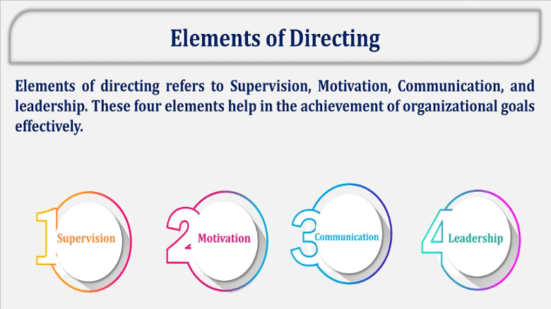

Slide 19
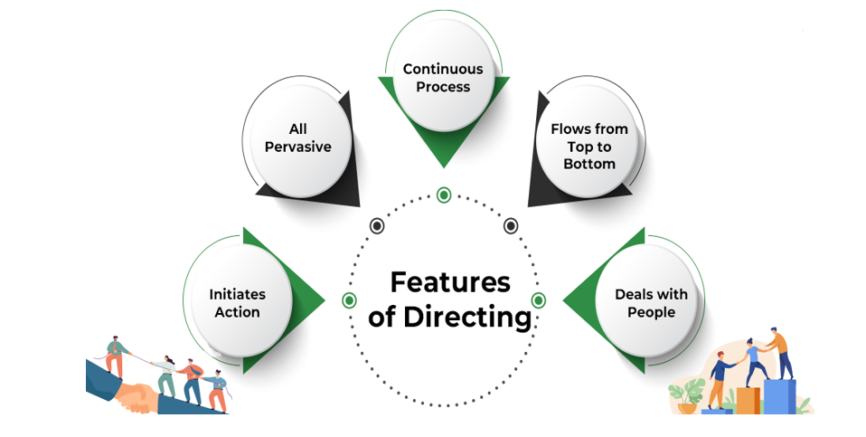

Slide 20
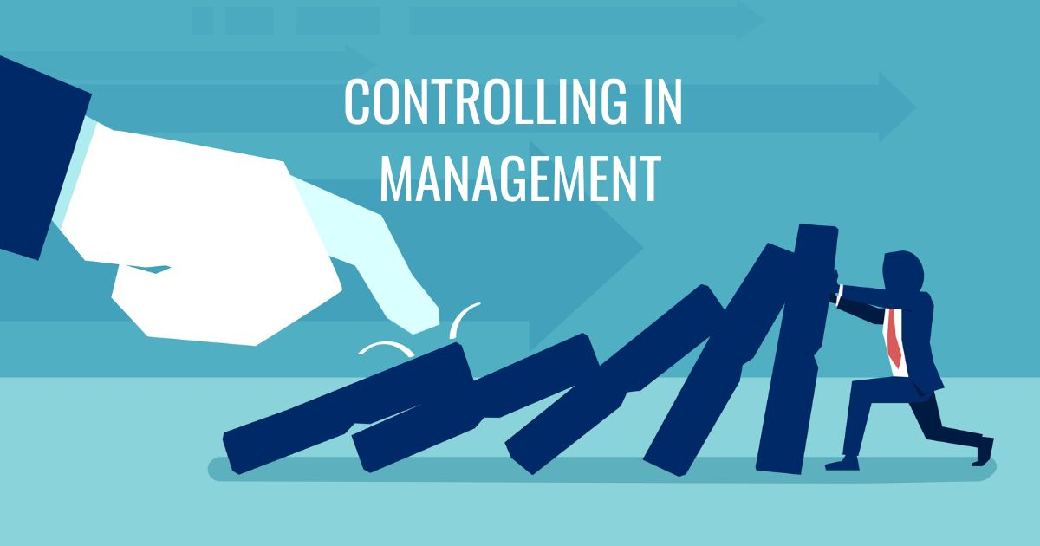

Slide 21
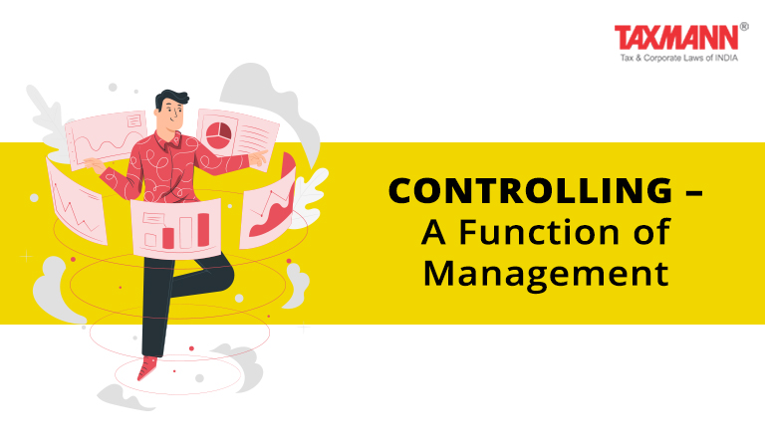
Controlling
Definition
controlling in management ensures there is no deviation from the plan and that, performance standards are met.
With the right type of control and action, the business manager can ensure adequate progress in a consistent way.

Slide 22
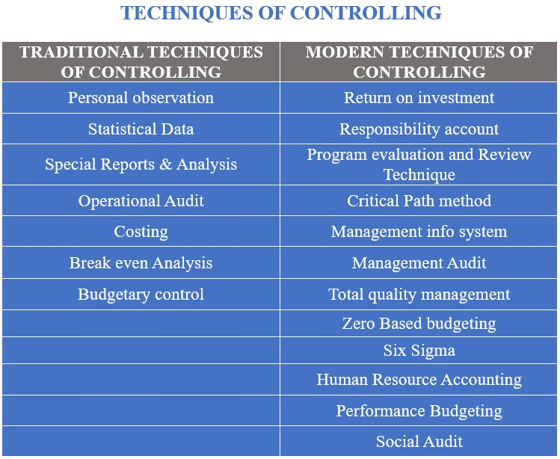

Slide 23
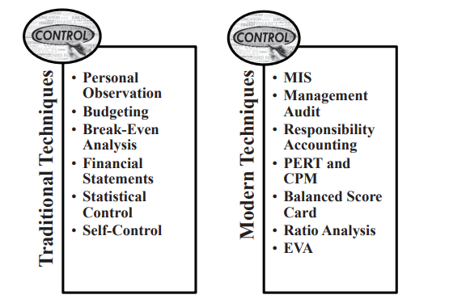

Slide 24
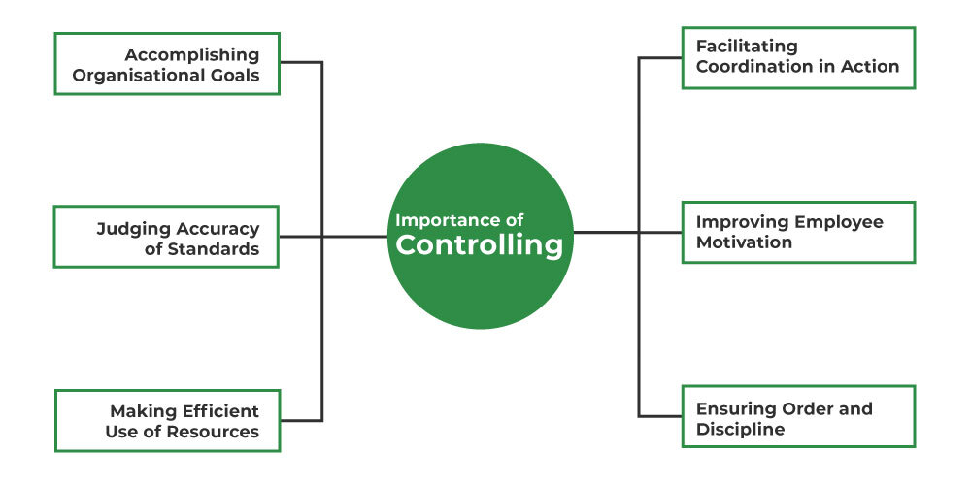

Slide 25


Slide 26
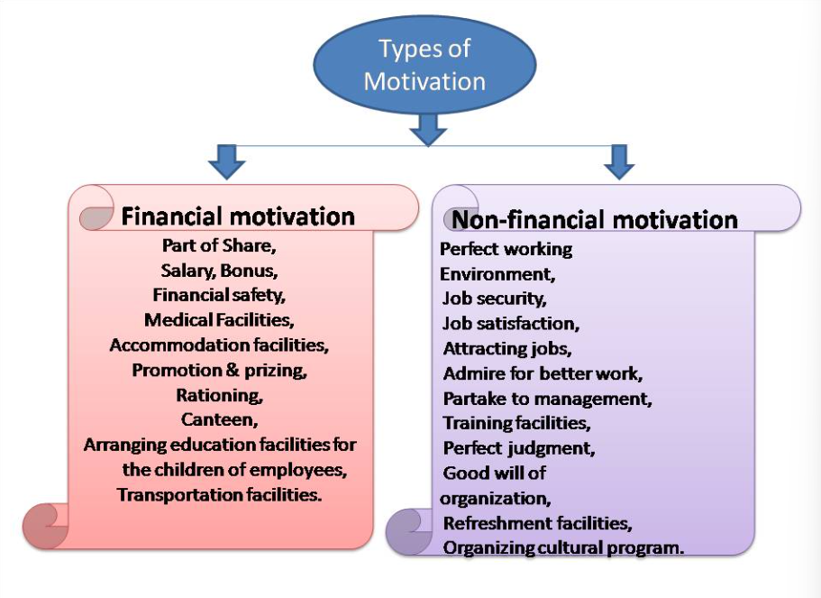

Slide 27
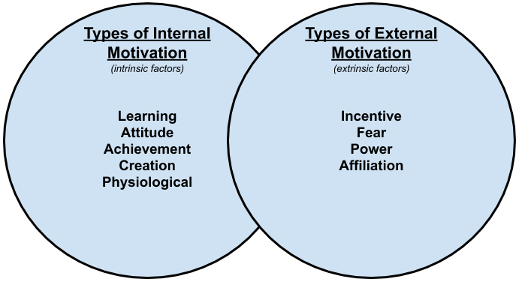
TYPES OF MOTIVATION: BASED UPON REWARDS

Slide 28


Approaches to Management
Classical Approach:
Scientific Management: Developed by Frederick Taylor, this approach emphasizes efficiency and productivity through the scientific study of work methods and the establishment of standard procedures.
Administrative Management: Proposed by Henri Fayol, this approach focuses on the functions of management and the principles that can improve managerial effectiveness, such as division of work, authority, and unity of command.
Bureaucratic Management: Introduced by Max Weber, this approach highlights the importance of a formal organizational structure with clear rules and procedures to ensure efficiency and effectiveness.

Slide 29
Approaches to Management
Behavioral Approach:
Human Relations Movement: Initiated by Elton Mayo and others, this approach emphasizes the importance of social factors in the workplace, such as employee morale, motivation, and group dynamics.
Organizational Behavior: This field studies the impact of individual and group behavior on organizational performance, including motivation, leadership, communication, and team dynamics.

Slide 30
Approaches to Management
Quantitative Approach:
Management Science: Uses mathematical and statistical techniques to solve complex management problems and make decisions.
Operations Management: Focuses on optimizing the production and delivery of goods and services, using techniques such as linear programming, queuing theory, and inventory management.

Slide 31
Approaches to Management
Systems Approach: Views an organization as an interrelated and interdependent set of elements functioning as a whole. Emphasizes the importance of understanding the relationships among the various parts of the organization and how changes in one part affect the others.
Contingency Approach: Argues that there is no one best way to manage. Instead, the most effective management practices depend on the specific circumstances or context, including the external environment, organizational size, and the nature of the work.

Slide 32
Approaches to Management
Contemporary Approaches:
Total Quality Management (TQM): Focuses on continuous improvement and customer satisfaction through the involvement of all employees in quality initiatives.
Lean Management: Emphasizes minimizing waste and maximizing value through efficient processes.
Six Sigma: Uses data-driven techniques to improve processes and reduce defects.

